Slide 1
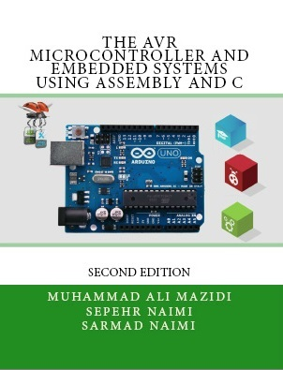

Output
Relay, Optoisolator, and Stepper motor interfacing with AVR
Sepehr Naimi
www.NicerLand.com

Slide 2
Topics
AVR Fan-out
Transistor
ULN2003
Relay
Opto-isolator
Stepper motor

Slide 3
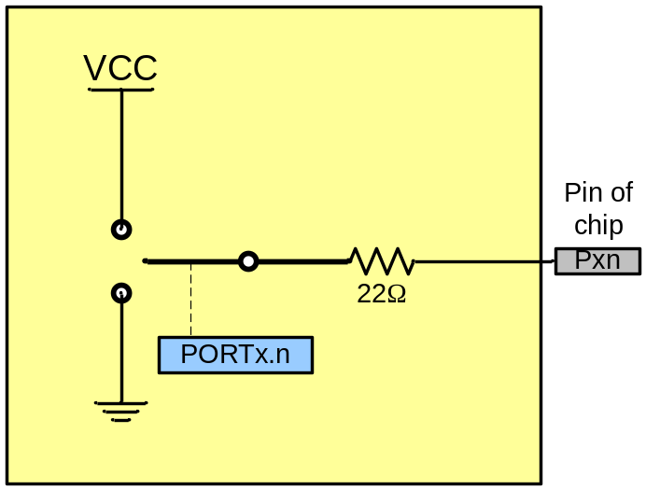
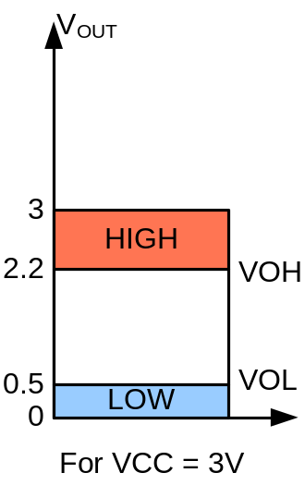
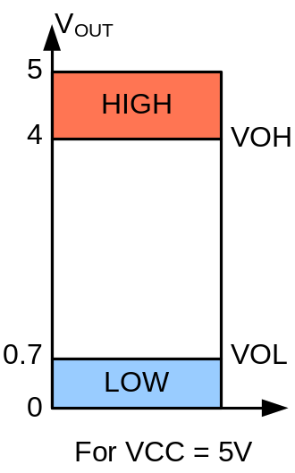
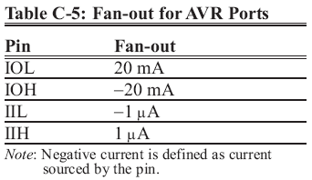
AVR Fan-out
Each I/O port can sink 20 mA at VCC = 5V and 10 mA at VCC = 3V

Slide 4
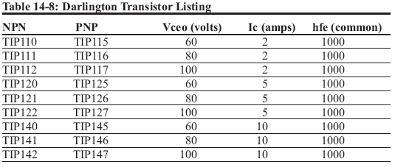
Transistor
We can switch devices using transistors.
Transistor amplifies signals.
VCC
AVR
Load

Slide 5
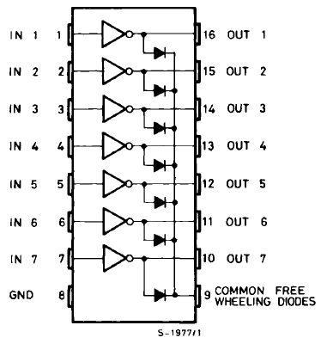
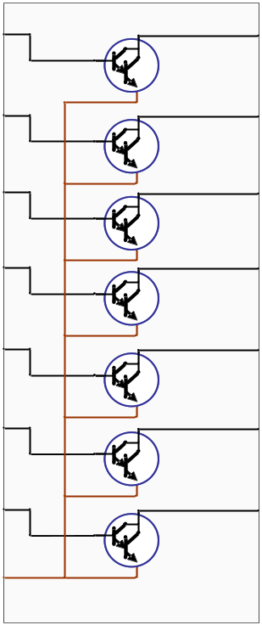
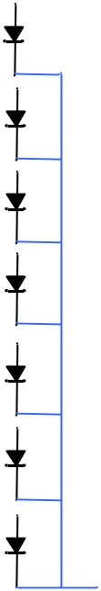
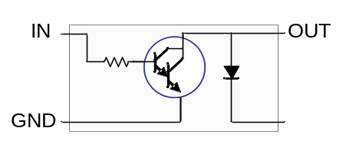
ULN2003
There are 7 Darlington transistors in a ULN2003.

Slide 6
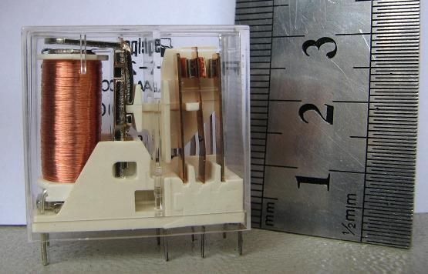
Relay
Relay is an electronic controlled switch.
It isolates two parts of a circuit from each other.
A small amount of current and voltage causes to switch a large amount of voltage and current.
Relay DPDT
Maximum output: 250V 8A ~AC
Input: 24^{V} DC

Slide 7
Relay parts
Relay has the following parts:
  Coil
  Contacts
  Spring

Slide 8
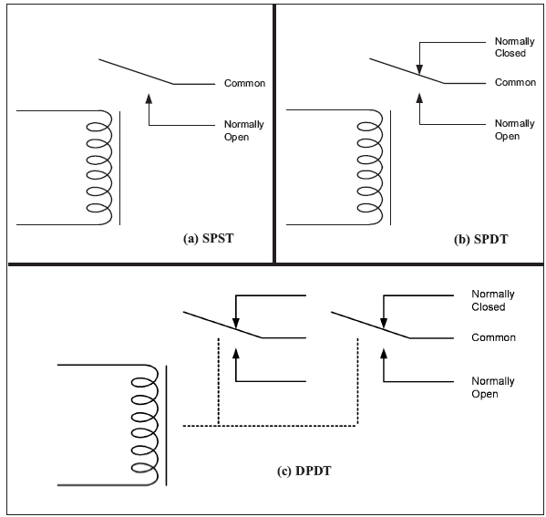

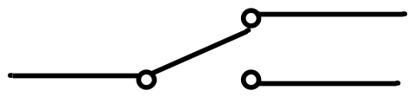
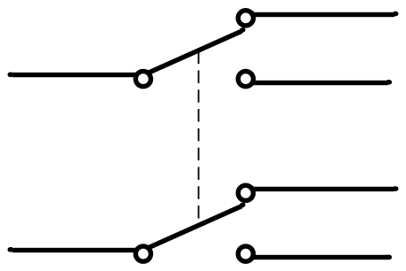
Contacts
SPST
SPDT
DPDT

Slide 9
Relay
+
-
~
220^{V}
12^{V}

Slide 10
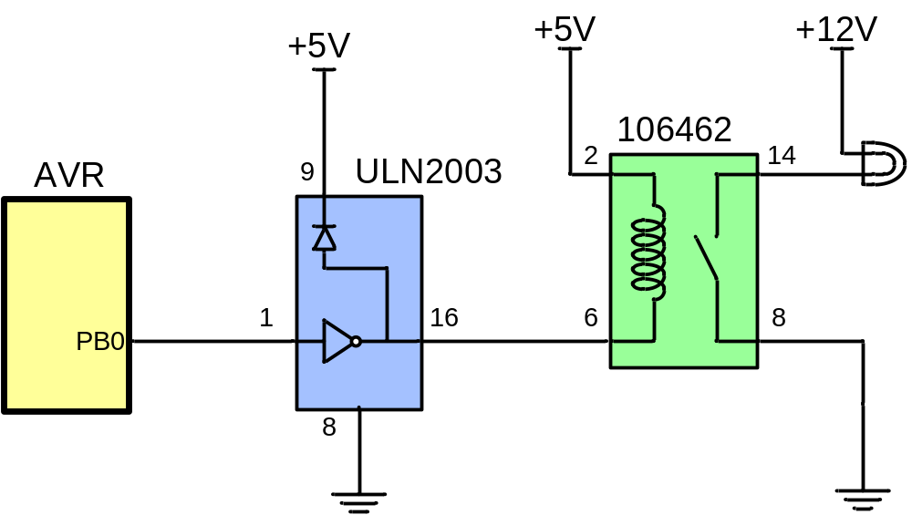
AVR connection to relay
Micro
Darlington
Relay
Lamp

Slide 11
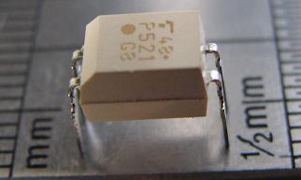
Optoisolator
Opto-isolator isolates two parts of a circuit from each other.
There is an LED in the input, and a photo-transistor in the output. When the LED lights up, the photo-transistor, senses the light and becomes conductor, and passes the current.
can be used in input or output circuits.
TLP521

Slide 12
Opto-isolator
16mA
10mA
TLP521

Slide 13

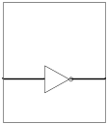

Controlling 220V devices
AVR
+12V
Analog Ground
Digital
Power
220^{V}
~
ULN2003
Analog
Power
in
out
+5^{V}
Digital Ground

Slide 14
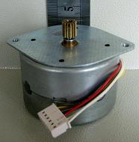
Stepper motor
Stepper motor is a motor, whose rotation angle is proportional to its input pulse.
Rotor
A
tooth
N
COM
S
S
N
N
B
S
Stator
C
COM
D

Slide 15
Stepper motor rotation
N
B
S
N
+5^{V}
S
S
N
S
N
S
N
N
D
S
N
S
C
+5^{V}
A

Slide 16
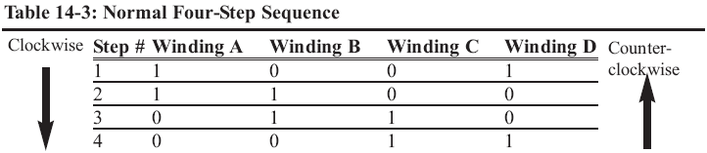
Stepping
N
B
S
N
+5^{V}
S
S
N
S
N
S
N
N
D
S
N
S
C
+5^{V}
A

Slide 17
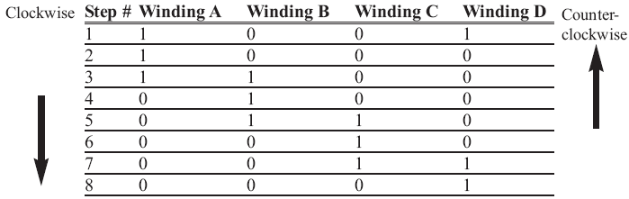
Half stepping
N
B
S
N
+5^{V}
S
S
N
S
N
S
N
N
D
S
N
S
C
+5^{V}
A

Slide 18
Calculations
N
B
S
+5^{V}
N
N
S
N
S
S
D
N
S
Step angle =
90
Num of teeth
A
+5^{V}
C
Steps per revolution =
360
= 4 * Num of teeth
Step angle
Steps per second =
RPM * Steps per revolution
60

Slide 19
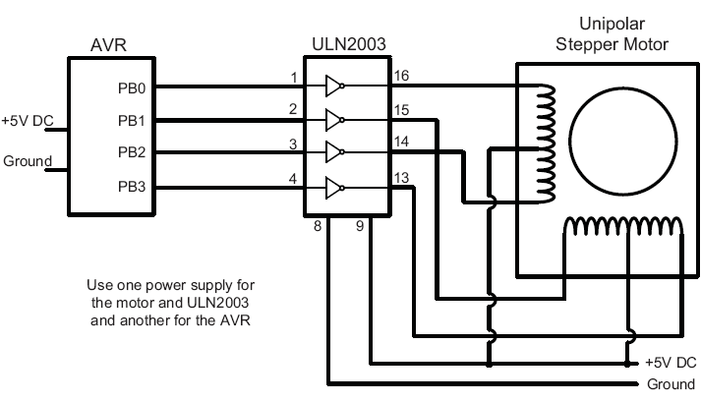
AVR and a Stepper motor

